Slide 1
Problem
Presentation
By: Ye Hun Joo and Josh Kuesters

Slide 2
Decision Problem
The decision problem is: Given a complete undirected weighted graph G, find if there is a Hamiltonian cycle and get its total weight
First we have to find all Hamiltonian cycles
Calculate the weight of each cycle
Return the weight of a cycle

Slide 3
Optimization Problem
The optimization problem is: Given a complete undirected weighted graph g, find the shortest Hamiltonian cycle in g and return its weight
Find all the Hamiltonian cycles
Find the weight of each cycle
Compare the weights and return the smallest

Slide 4
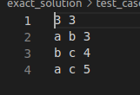
Inputs and Outputs #1

Slide 5
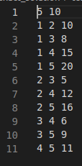
Input and Output #2

Slide 6
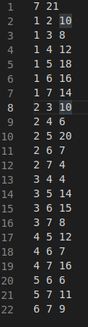
Input and Output #3

Slide 7
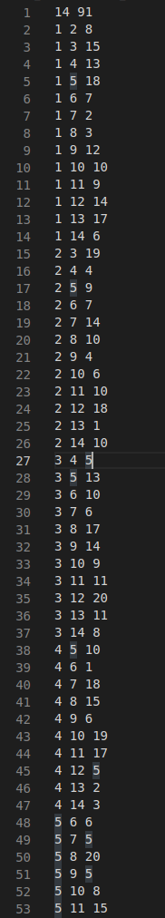
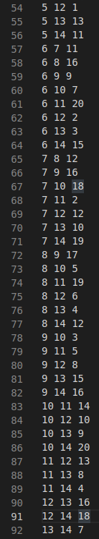
Input and Output #4 (won’t finish in reasonable time)

Slide 8
Why is it Important?
It is a difficult optimization problem with real world uses:
Train transportation systems
Planning which holes to drill in a circuit board
Flight patterns
As always solving it can lead to solutions for all similar problems

Slide 9
Certifier Process
The certifier has two parts:
Every vertex in the graph has been visited
Check if the length of the path equals n
The total cost is the lowest it can be
Compare the cost of each permutation

Slide 10
Reduction
Hamiltonian cycle to Traveling Salesman Problem
Construct a complete weighted graph G' by assigning a weight to each edge in G
If there is an edge (u, v) in G, we set the weight of the corresponding edge in G' to 1
If there is no edge between vertices u and v in G, we set the weight of the corresponding edge in G' to 2
We can now show that G has a Hamiltonian cycle if and only if G' has a TSP tour of length n
If G has a Hamiltonian cycle, then we can construct a TSP tour in G' by following the same sequence of vertices in the Hamiltonian cycle
adding up the weights of the edges instead of just checking for their existence
The total length of the TSP tour will be n, which is the number of vertices in the graph

Slide 11
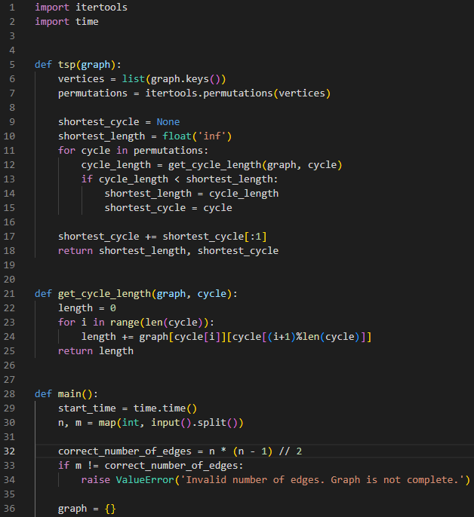
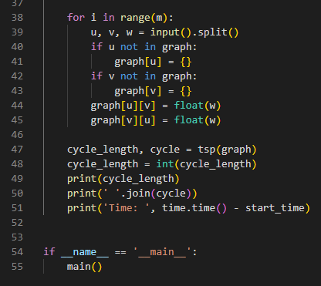
Code explanation
Map out the graph into an adjacency matrix with the weight of the edge at (i,j)
Then uses the itertool permutations to map out all cycles
Next it goes through each cycle and checks the length
It keeps track of the shortest
Returns the shortest length and the cycle

Slide 12
Runtime
The program runs in O(n!)
The most costly part is the iteration of the permutations call
Has a complexity of O(n!)
The get_cycle_length method is the second most costly O(n)
Iterates over all the vertices in the current cycle
The overall time complexity is O(n! * n) but n! dominates over n in large inputs

Slide 13
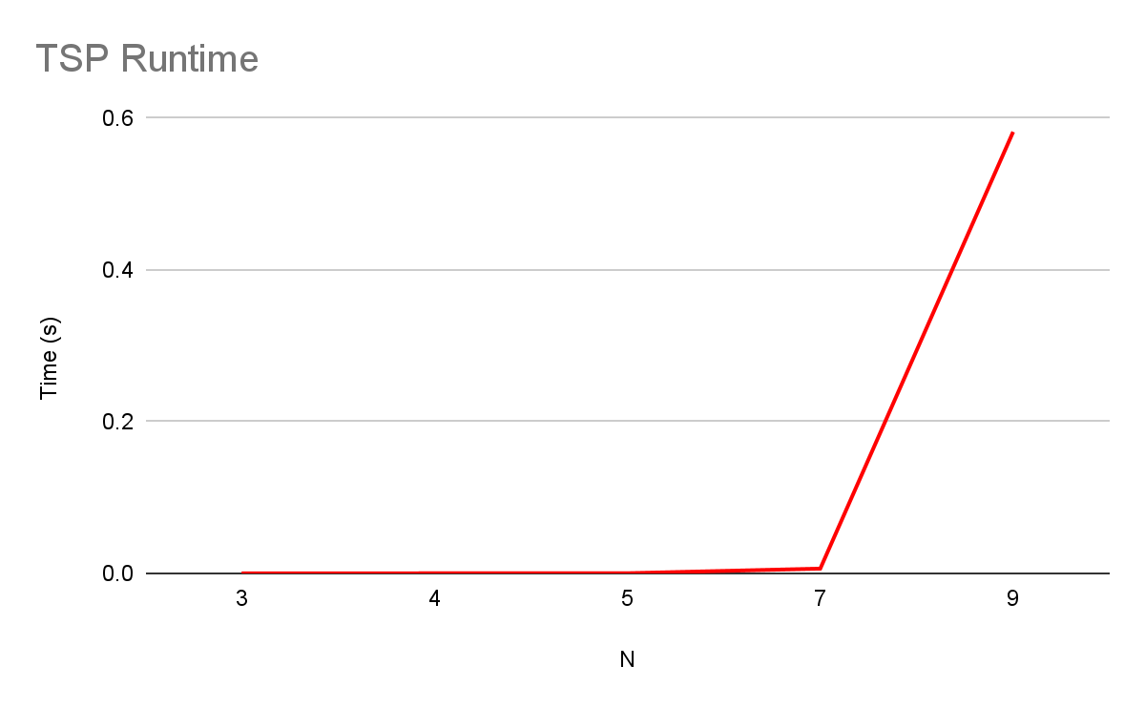
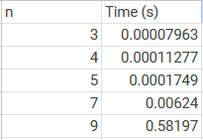
Results

